Slide 1
On effect of sampling procedure on RNN performance
27 November 2020
Leodegario Lorenzo II

Slide 2
Time-series forecasting
Step
Sample
Target
Lookback
Delay
Sample: Set of historical values used as predictors
Lookback: How far back in history we look to construct the sample
Delay: Time difference between target and sample
Step: Time step between values within the sample; period

Slide 3
Time-series sampling procedure
Sample 1
Target 1
Samples
Targets
Sample 2
Target 2
Sample 3
Target 3
By default the generator function picks the first value in within each timesteps

Slide 4
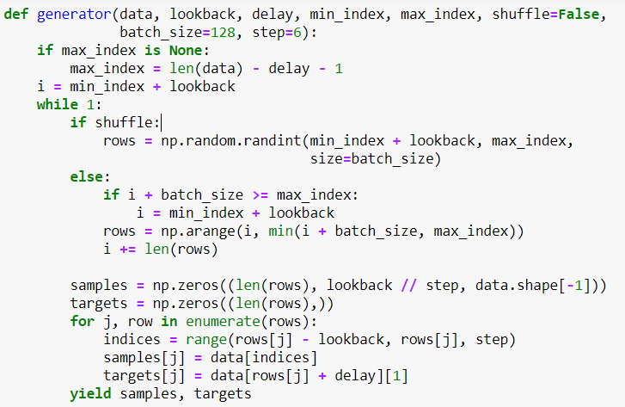
Time-series sampling procedure
Sample
Target
rows[ j ] - lookback
rows[ j ]
Getting the indices of the sampled values:
indices = range(rows[ j ] – lookback, rows[ j ], step)

Slide 5
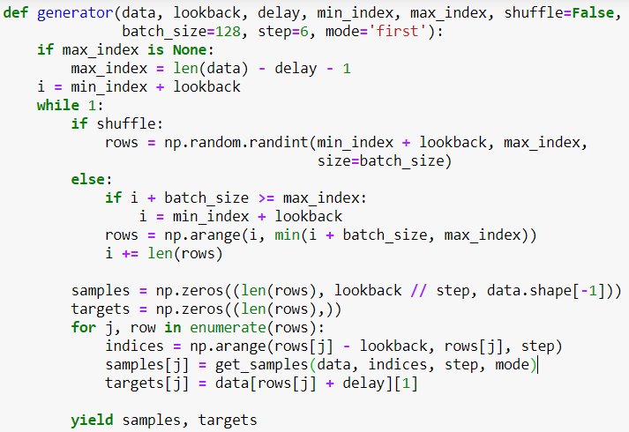
Adding a sampling aggregation
Old
New

Slide 6
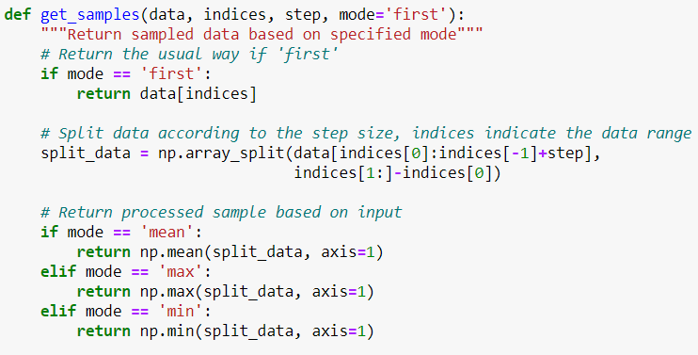
Adding a sampling aggregation
Sample

Slide 7
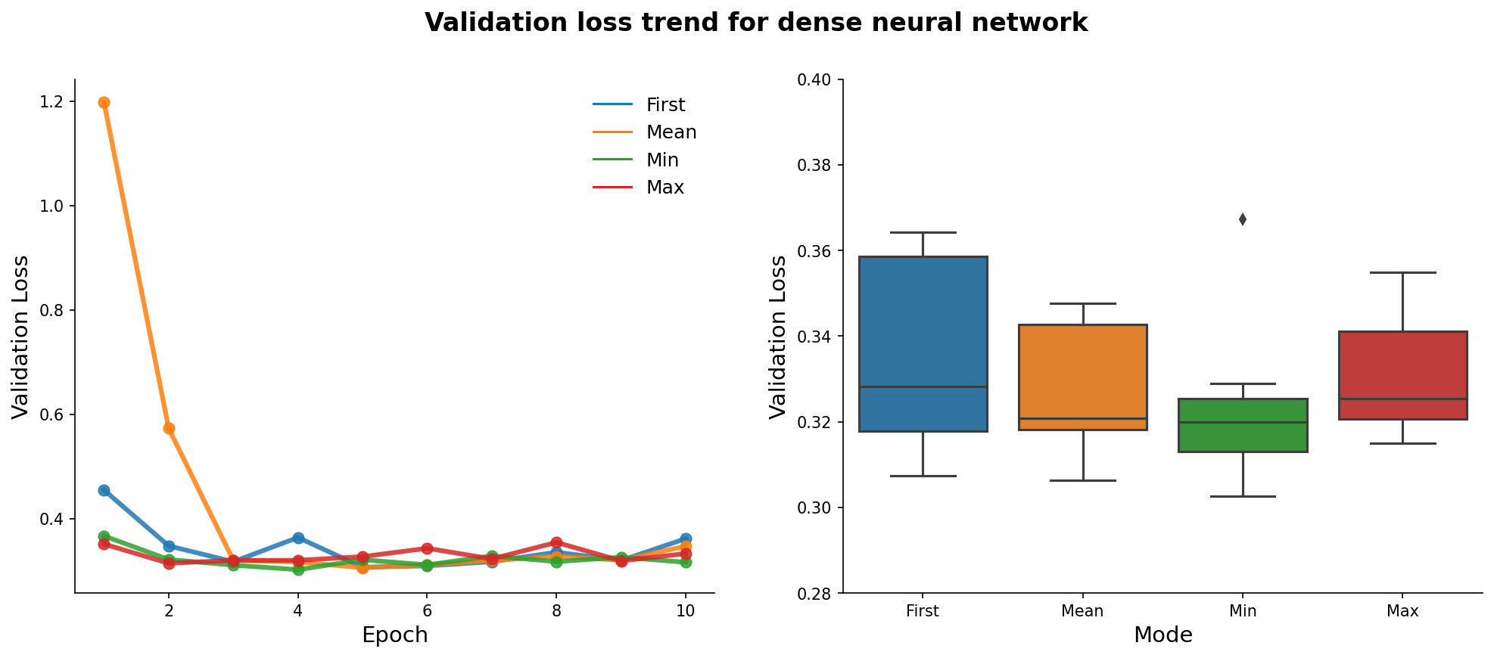
Validation loss: Dense NN

Slide 8
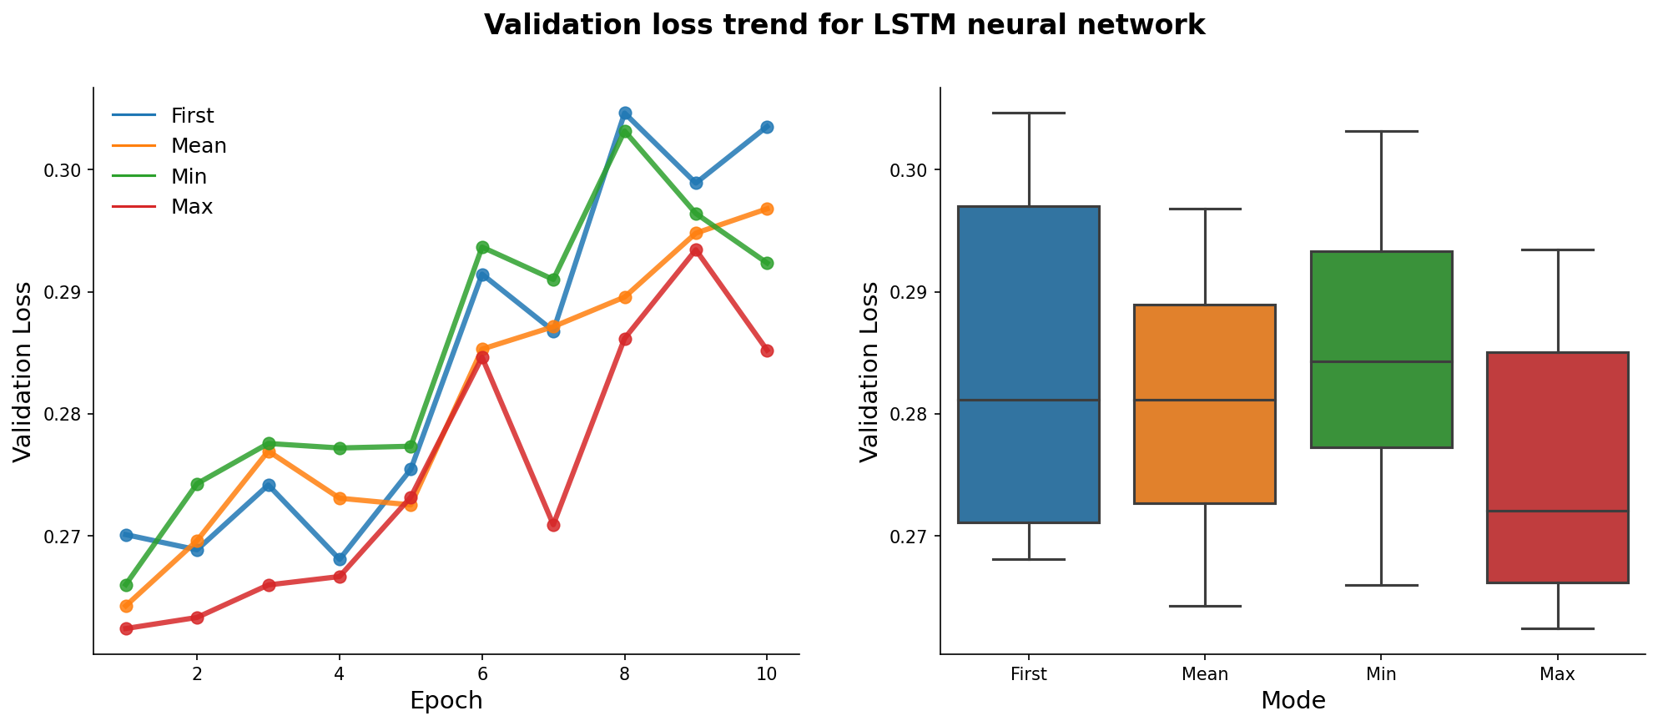
Validation loss: LSTM

Slide 9
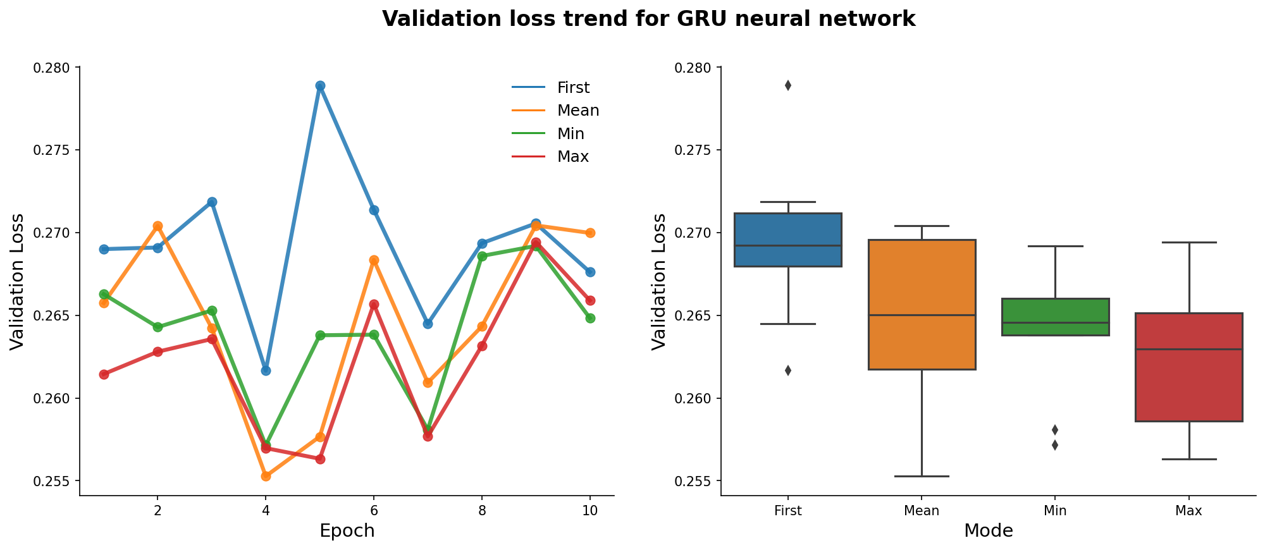
Validation loss: GRU

Slide 10
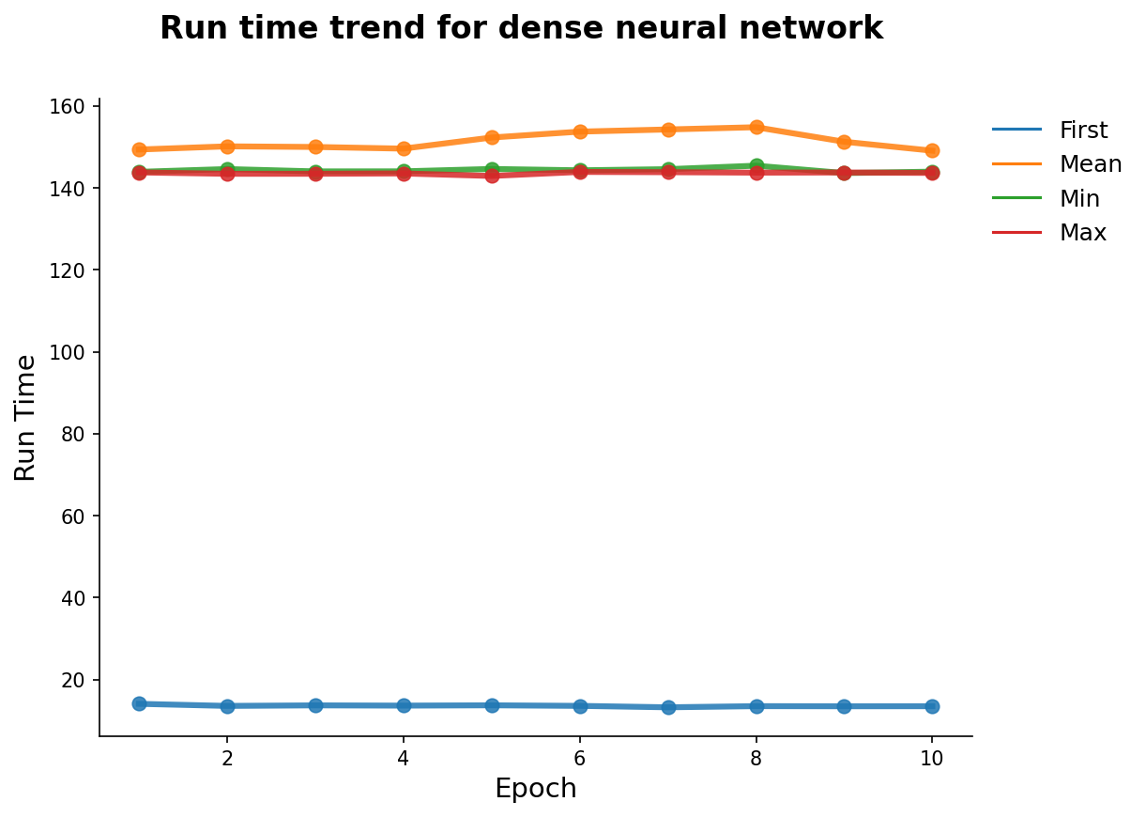
Run time: Dense NN
Time difference between ‘first’ and other modes is about 132.9 secs on average.

Slide 11
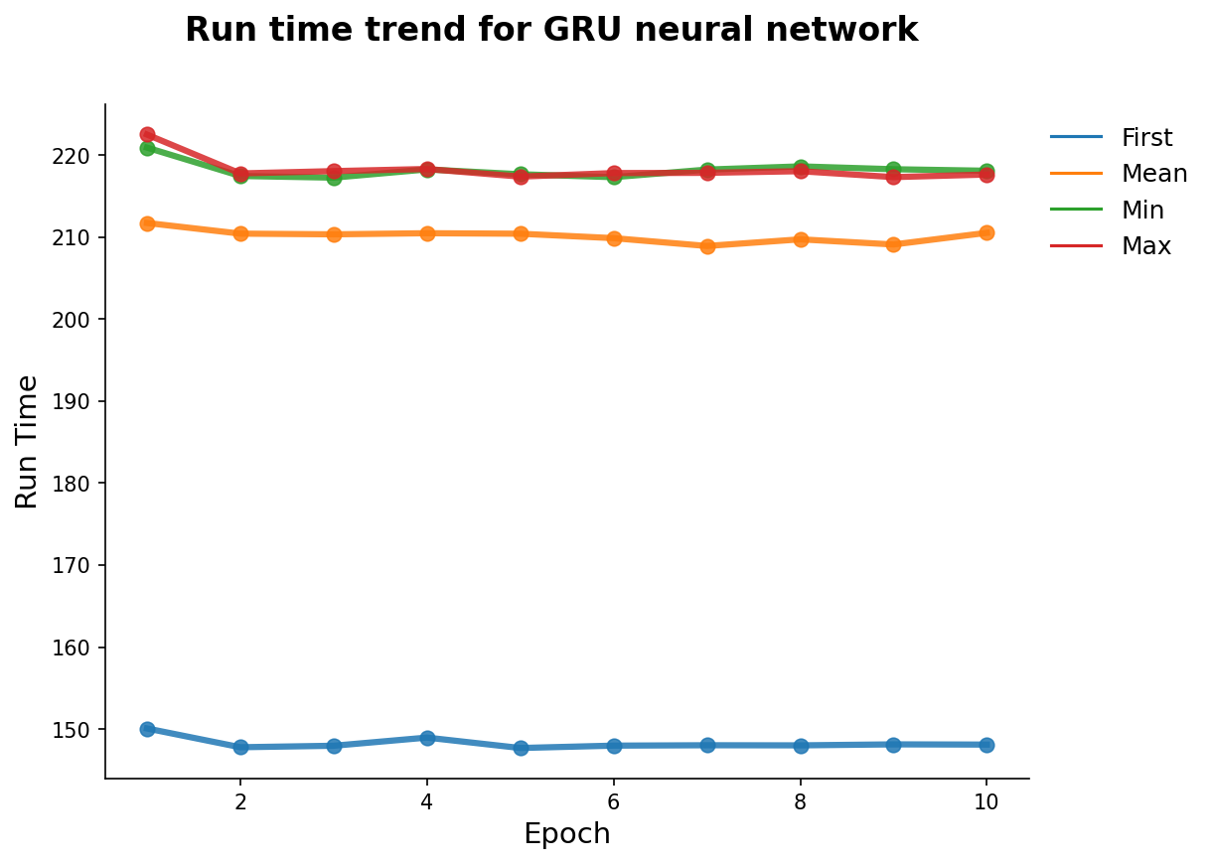
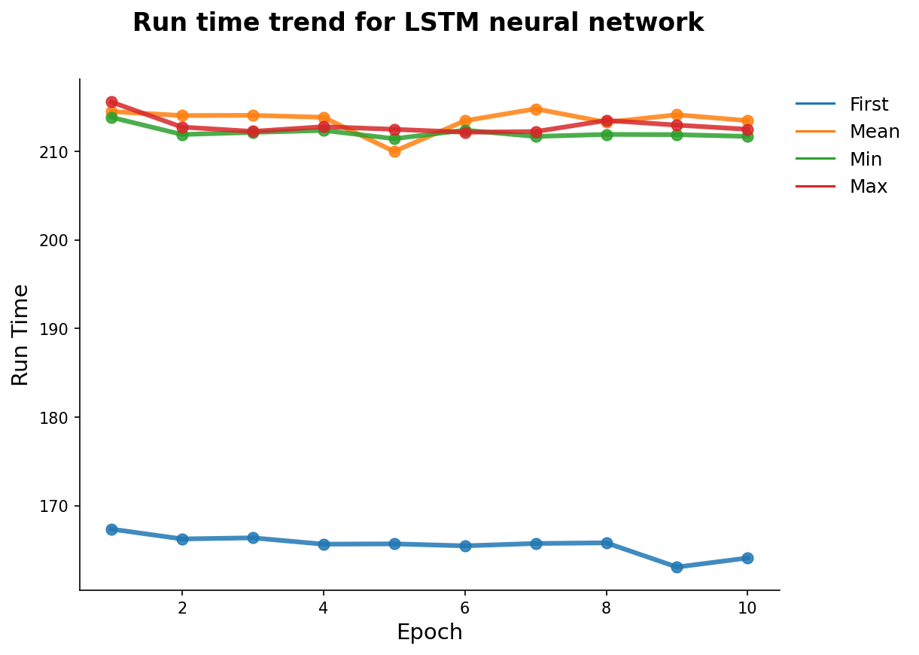
Run time: LSTM and GRU
Time difference between ‘first’ and other modes is about 47.3 secs and 67.3 secs for LSTM and GRU respectively.

Slide 12
Key takeaways
Gained deeper understanding of the sampling procedure for time-series problems.
Marginal gains in the accuracy of the model can be achieved by properly selecting the sampling procedure.
The gain comes with computational cost. Thus, general advice is to perform aggregation operations as a final step to further optimize the accuracy of the model.
Model | Decrease in MAE | In terms of (°C) | Additional Runtime (secs)
Dense | -0.004696 | -0.042 | 132.86
LSTM | -0.005667 | -0.050 | 47.33
GRU | -0.006372 | -0.056 | 67.29

